Slide 1
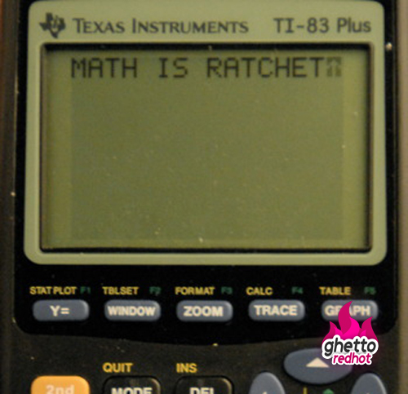
Biostats Journal Club 1: Simple Linear Regression and Intro to R
Dropbox link <- https://tinyurl.com/Biostats1
Ryan Boileau
DSCB Second Year, Blelloch Lab
2.15.18

Slide 2
Today’s Structure
The paper
-Regression analysis
-The math basics
-Considerations and common mistakes
Introduction to R
Exercises combining statistics and R skills

Slide 3
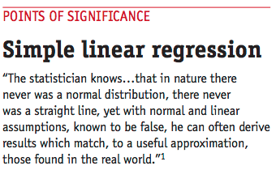
Regression analysis: A set of statistical approaches to estimating the relationship among variables

Slide 4
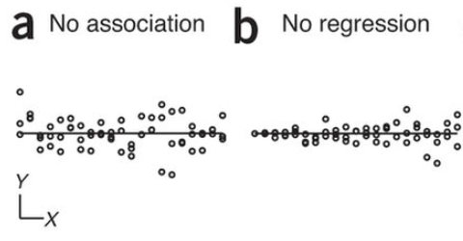
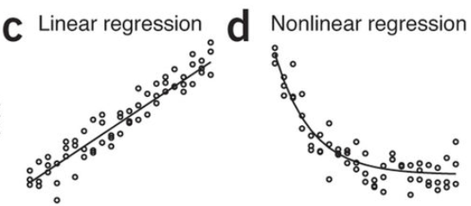
Simple Linear Regression
With independent variable x, can you estimate dependent variable y?
-There is a regression
relationship when the mean of Y changes with X

Slide 5
Assumptions
Variability is constant
Data points are independent, different samples
Y is not intertwined with X
X measurements are precise

Slide 6
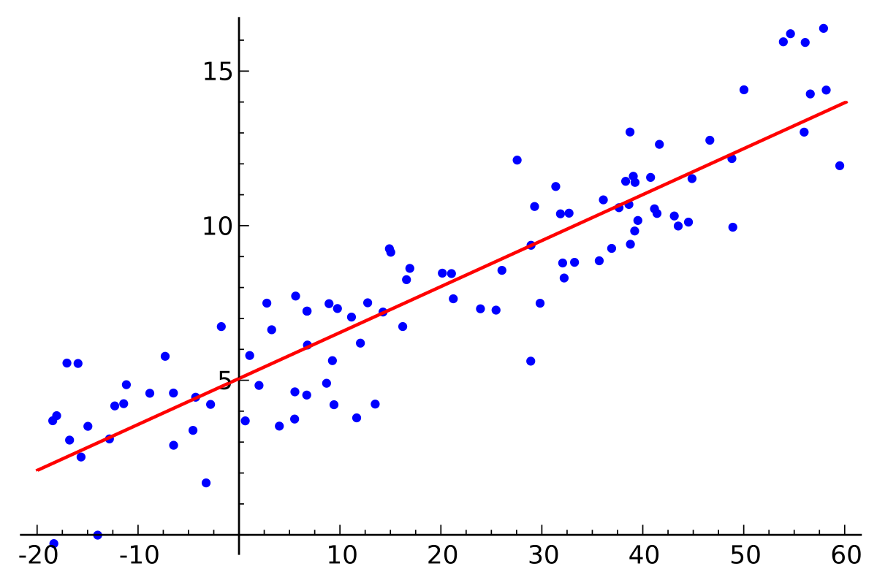
Math Part – The basics
“Estimating the value of Y with X”
Condition Expectation E(Y|X) = µ(x)
µ <- “population mean in statistics”
µ(x) = ß_{o}+ß₁x
ε = Y - µ(x)
Wikipedia

Slide 7
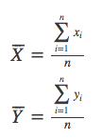
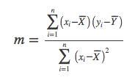

Math Part – Least Squares Estimation: Generating a best fit line
1. Find the means of all X and Y values
2. Find the slope using standard deviations and R (simplified here)
3. Use that high school algebra to find Y-intercept b
*LSE approach seems to work best for general error distributions. Susceptible to major outliers. Use diagnostic outlier tests prior to analyses

Slide 8
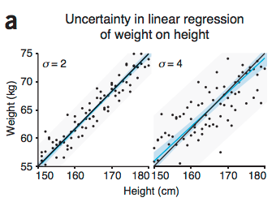
Math Part – Assessing the outcome
Confidence in a single point µ(x) = ß_{o}+ ß₁x ± t_{0.95}SE(ŷ(x)
R² – Coefficient of determination.
How well the regression line approximate real data points, “Goodness of fit”
versus R (coefficient of correlation) measures the strength and direction of

Slide 9
Common Mistakes
Concluding no relationship between X and Y when R² is low
Extrapolating beyond the data
Fitting to rolling averages or smoothed data

Slide 10
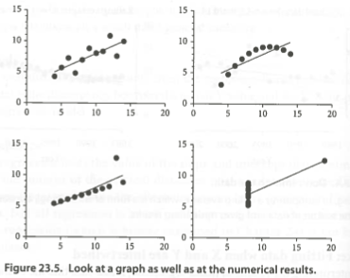
Identical statistics with different data

Slide 11
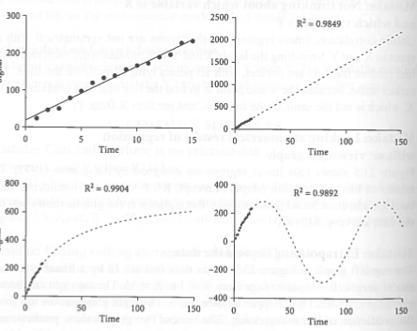
Extrapolating beyond the data is a no no

Slide 12
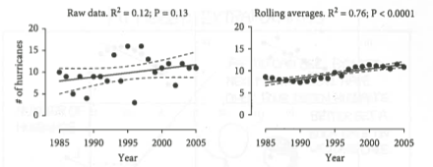
Fitting to smoothed data is also a no no

Slide 13






Slide 14

Basic data types in R
Integers
Numerics (e.g. numbers with decimals)
Logical (Boolean Values e.g. TRUE or FALSE)
Characters (Strings)
Unsure? Run the function: Class(“name_of_variable”)

Slide 15
Data structures in R
Vectors- one dimensional arrays that can hold either numeric, character, or logical data
Vector <- c(“item1”, “item2”)
Matrix- two dimensional arrays with rows and columns, same type of data
Data frame- two dimension array, can hold multiple data types

Slide 16
Using data structures
Math with structures:
e.g. You can add vectors together, sum all of the numbers in one vectors
>Combined_vector <- vector1 + vector2
Subtraction, division, multiplication, all the good stuff

Slide 17
Using data structures
Referencing elements in data structures:
i.e. in vectors, lists:
>vectorname[1] #selects first element in the vector
>vectorname[1:5] #selects the first five elements
in matrices, data frames:
>dataframe[1,4] #selects first row, element 4
>dataframe [1:5, 4] #selects element 4 in the first 5 rows
>dataframe[3,] #selects all elements in row 3

Slide 18
Functions()
#The built-in basic plot function plot()
>plot(x, y, main=“TITLE”, ylab=“Yaxis_label”, xlab=“Xaxis_label”)
#The built-in linear modeling function lm()
>lm(formula, data, subset, weights, na.action,
method = "qr", model = TRUE, x = FALSE, y = FALSE, qr = TRUE,
singular.ok = TRUE, contrasts = NULL, offset, ...)

